Slide 1

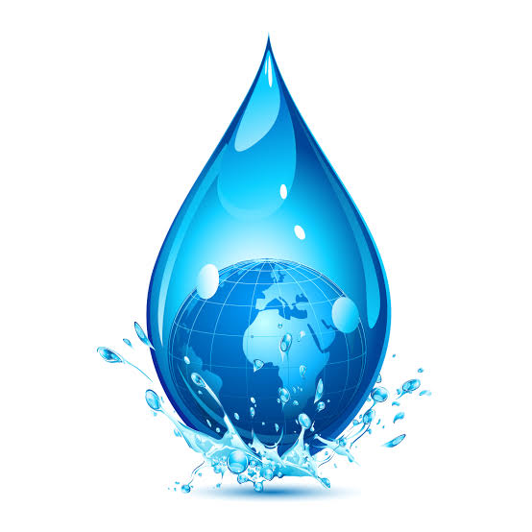
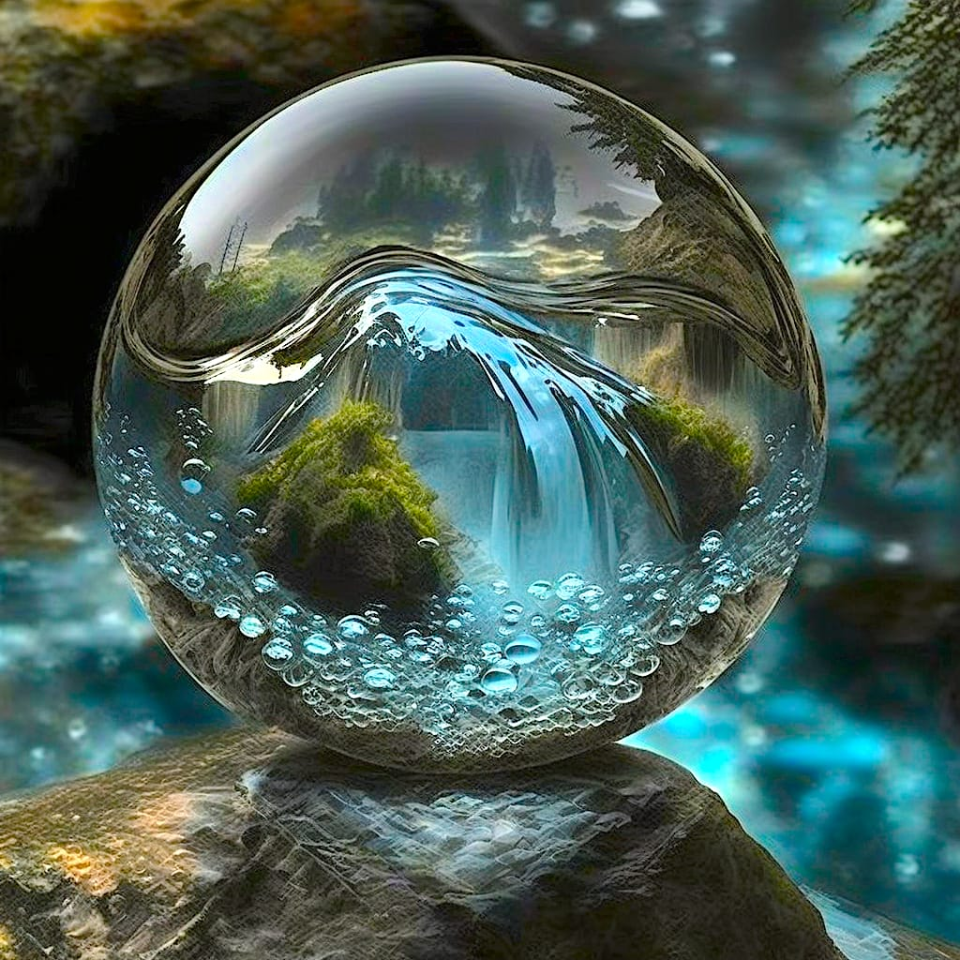

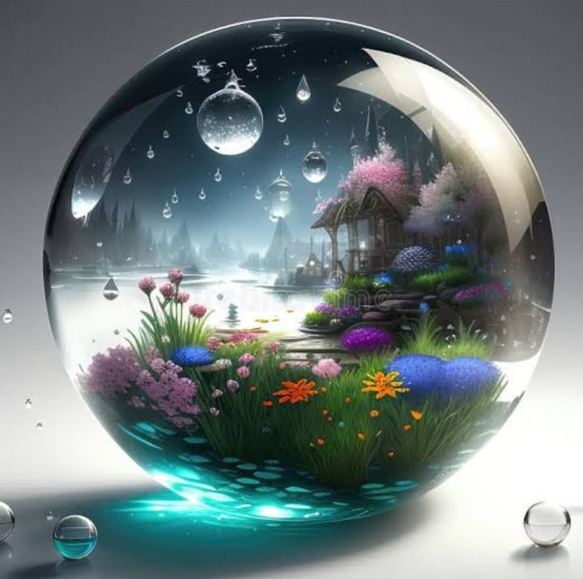
SMART
WATER
SYSTEM
GANTHI PARUSHARAMUDU G
MANOJ KUMAR
KAVIYARASU A

Slide 2

.
Project Definition: The project involves implementing loT sensors to monitor water consumption in public places such as parks and gardens. The objective is to promote water conservation by making real-time water consumption data publicly available. This project includes defining objectives, designing the loT sensor system, developing the data-sharing platform, and integrating them using lot technology and Python.
Project Objectives:
Real-time Monitoring:
Implement IoT sensors to continuously monitor water sources, distribution networks, and usage patterns to gather real-time data.
Water Quality Assurance:
Ensure the water quality is maintained within specified standards by monitoring parameters such as pH, turbidity, chlorine levels, and contaminants.
Leak Detection:
Detect and pinpoint leaks in the water distribution system to minimize water wastage and reduce repair costs.
Water Conservation:
Develop mechanisms for reducing water consumption through smart metering, timely alerts to consumers, and incentives for conservation.
Predictive Maintenance:
Implement predictive maintenance algorithms to identify potential system failures, enabling timely repairs and reducing downtime.
Data Analytics:
Analyze the collected data to gain insights into water usage trends, optimize distribution, and plan for future demand.
Integration with Existing Systems:
Ensure seamless integration with existing water infrastructure, including SCADA systems, to enhance overall efficiency.

Slide 3
Real Time Monitoring and Control of Water Consumption
1
Usage Tracking 📝
Smart water systems track real-time water usage, allowing customers to monitor their consumption and set usage targets.
Leak Detection 🚨
2
These systems can detect leaks in real-time and send alerts to customers to address the issue before it becomes more severe.
3
Flow Control 🚰
Flow control allows companies to manage water usage in real-time by remotely controlling water usage through the IOT sensors.

Slide 4
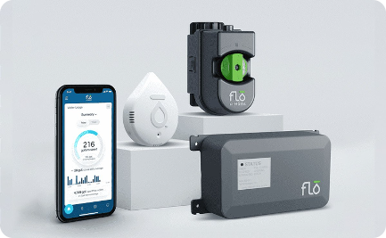
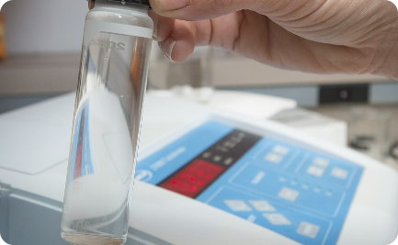
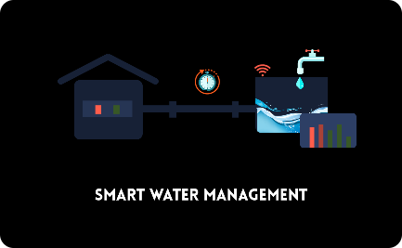
Water Quality Assurance
Data Collection 📈
Analytics 📊
Reporting 📜
IOT sensors collect and transmit data on water usage, pressure, and flow.
Cloud-based analytics analyze data trends, detect anomalies, and provide insights to optimize water usage.
Reports provide key information on water usage, leaks, and anomalies to help companies identify areas for improvement.

Slide 5
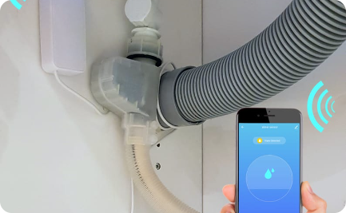

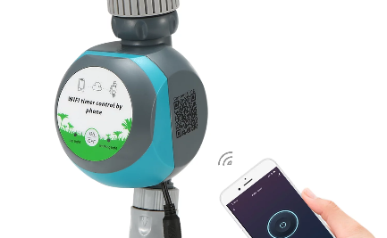
Detection and Prevention of Water Leaks
Leak Detection 🔍
Damage Prevention 🔧
Remote Control 📡
IOT sensors detect leaks in real-time, allowing companies to quickly address the issue and minimize damage caused by leaks.
By detecting leaks early, smart water systems can help minimize water damage and prevent costly repairs.
Remotely control water usage to prevent leaks and minimize water waste even when customers are away from home.

Slide 6
Components and Technologies in a Smart Water System
1
IOT Sensors 📡
IOT sensors collect data on water usage, pressure, and flow to provide real-time insights and analysis.
Mobile App 📱
2
A user-friendly mobile app allows customers to monitor their water usage, set targets, and receive alerts for leaks or abnormal usage patterns.
3
Cloud-based Analytics ☁️
Cloud-based analytics help companies analyze data, detect patterns, and optimize water management strategies.

Slide 7
Real-Life Examples of Successful Implementation of Smart Water Systems
1
Las Vegas Valley Water District
2
The LVVWD implemented a smart water system to reduce water consumption, resulting in significant cost savings and a more sustainable future.
Kansas City Water Services Department
The K.C. Water Services Department implemented a smart water system with IOT sensors and a mobile app, reducing water usage and saving money for residents.
3
City of Cape Town Water and Sanitation
The City of Cape Town implemented a smart water system using cloud-based analytics to monitor water consumption, detect leaks, and reduce water waste.

Slide 8
Benefits of a Smart Water System
Cost-effective 💰
Sustainable ♻️
Efficient ⚡️
Smart water systems can detect leaks and reduce water waste, resulting in lower water bills and overall cost savings.
These systems help reduce water waste, conserve resources, and minimize environmental impact.
Smart water systems automate processes and provide real-time data, allowing for faster leak detection and more efficient water management.

Slide 9



